Slide 1
Custom AI Expert Chatbot solutions
 | Finetune LLM | Knowledge Base
Usage | Behave a certain (e.g., talk like Biden) | Gain domain knowledge
How it works | During supervised training phase, teaching new task by providing additional question-answer pairs. | Look up user’s question in DB’s relevant docs → Feed user’s question & relevant info into LLM
Accuracy | Prone to confabulation and hallucination | Recalls exact information
Maintenance | Requires constant retraining | Adding new vectors is easy
Scale | Not scalable | Infinitely scalable
Cons | Slow, difficult, expensive | As effective as the intelligent search tool
Cost * | Expensive: | Cheaper:
*With a relatively-small custom dataset of 1M tokens (~200,000 words or ~400 Wikipedia articles) & an average query using 1000 tokens

Slide 2
Why choose Knowledge base over Fine-tunning?
Semantic search is 10,000,000x faster
Semantic search is 10,000,000x cheaper
Finetuning for knowledge does not work, semantic search does
Semantic search does not confabulate
Basically, Finetuning is for Structure, not Knowledge

Slide 3
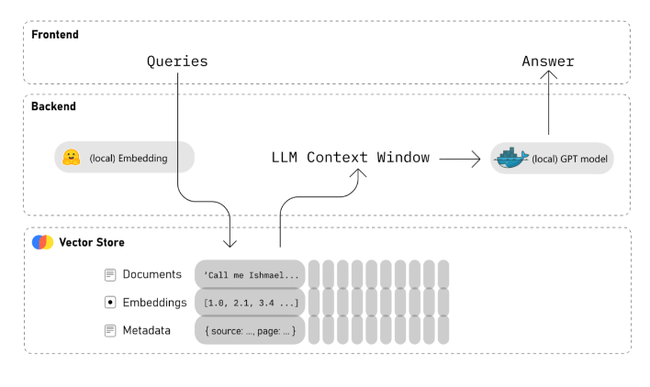
How does Knowledge Base approach work?
processing your custom body of knowledge and create Embeddings for it
Based on the question, find the Embeddings which are most relevant for the question
Create a prompt containing the most relevant embeddings and use the Completions API to answer the question

Slide 4
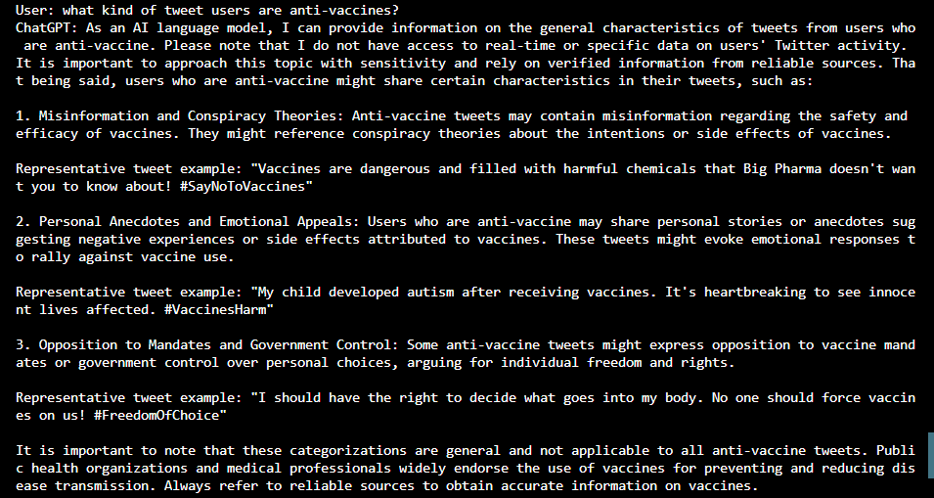

Slide 5
